Slide 1
WANDERING IN THE WOODS
Submitted By

Slide 2
INTRODUCTION
The project highlighted the need of computation thinking process among K-8 students.
It will improve the calculative skills among the students.
The approach of developing computer simulation will also change in positive context.

Slide 3
PROJECT OVERVIEW
The main goal of this project is to provide a game application to students of different level.
It is looking for the digital platform that can be used by students and it improve their mathematical skills.
Three phases of project has been decided and it corresponds to K-2 students, grade 3-5 student and grade 6-8 students.

Slide 4
THEME OF GAME APPLICATION
Game application is built on the theme called “lost in the woods”.
Player will get lost in the woods presented in a rectangular grid.
It is a dense woods and a player of one cell cannot hear the other player sound resides in another cell.

Slide 5
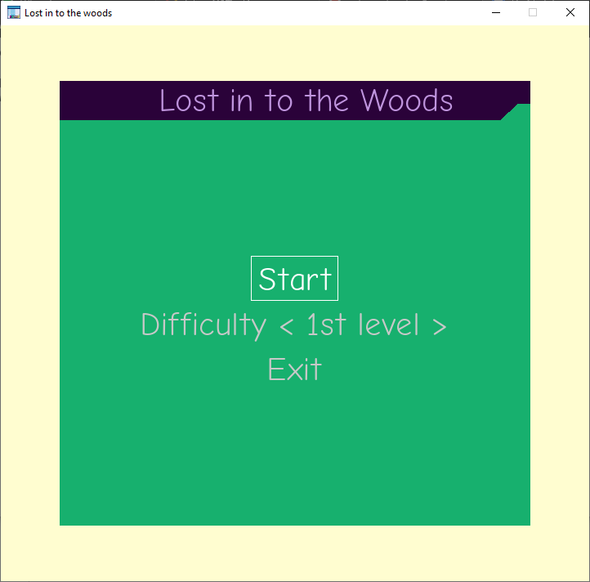
GAME APPLICATION-LEVEL 1
It is an easy level of Game that is build for Grade K-2 students.
The motive of this level of game is basically entertain the students.
Student will choose the Difficulty Level-1 where number of columns and rows will be less.

Slide 6
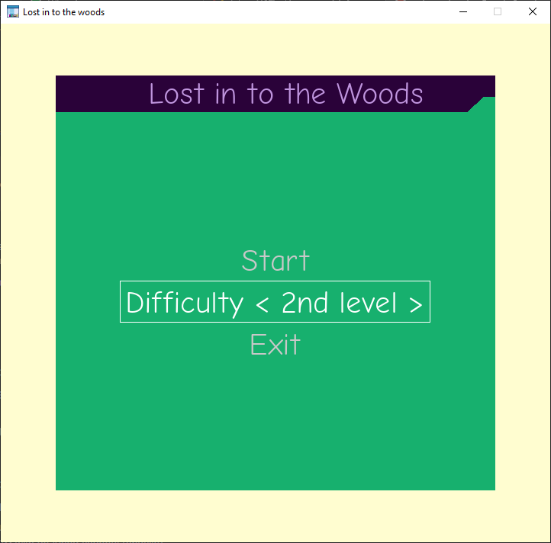
GAME APPLICATION-LEVEL 2
It is a level of game which is presented for Grade 3-5.
Student will choose the difficulty Level-2 for gaining more number of cells in comparison to Level-1.
Students will face a bit of more complexity in comparison to basic one.

Slide 7
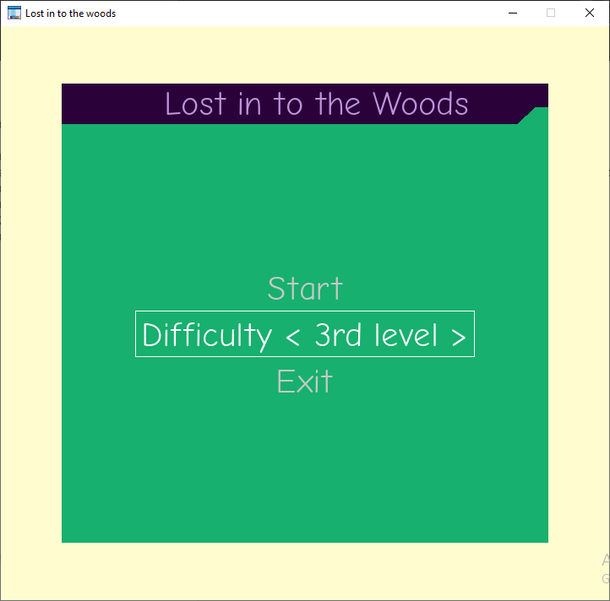
GAME APPLICATION-LEVEL 3
It is a difficult level of game which will be played by students of Grade 6-8.
The complexity level of game has been increased by increasing the number of rectangular grids.

Slide 8
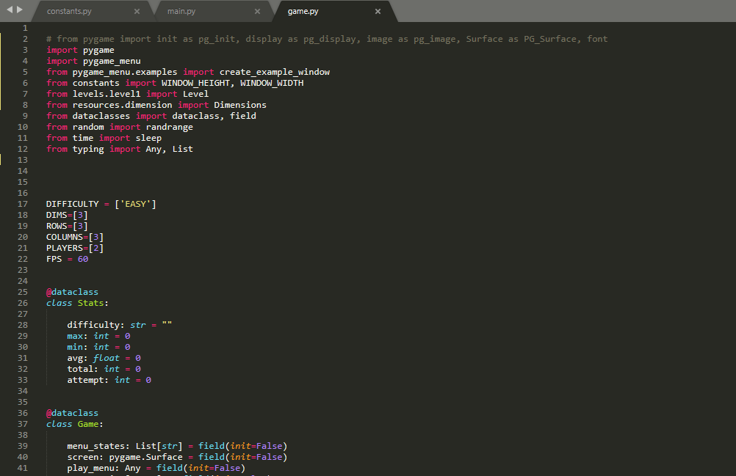
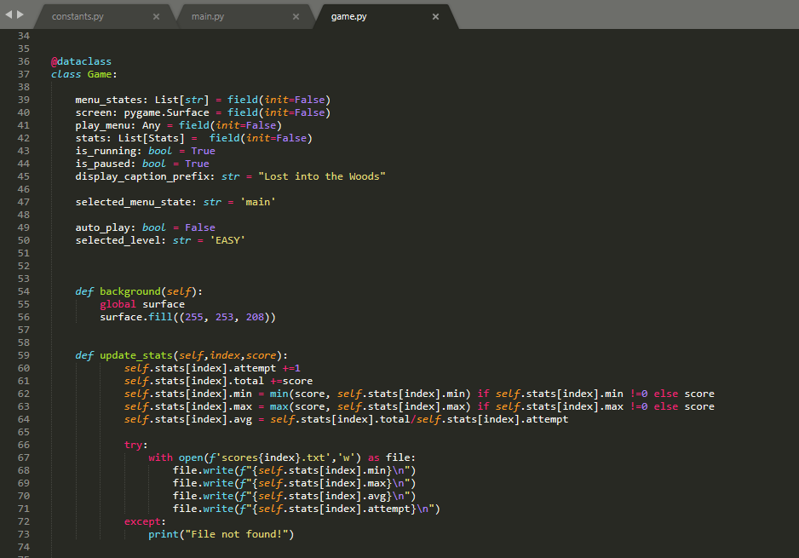
CODE FOR LEVEL 1, LEVEL 2 & LEVEL 3

Slide 9
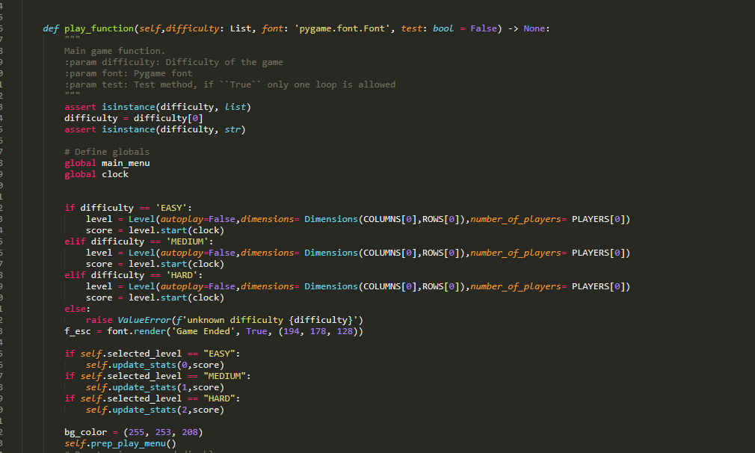
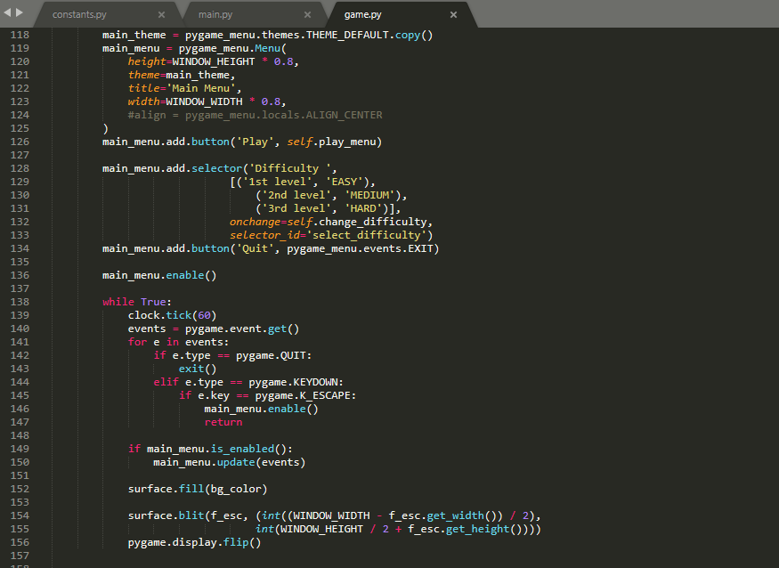
CODE (CONTINUED…)

Slide 10
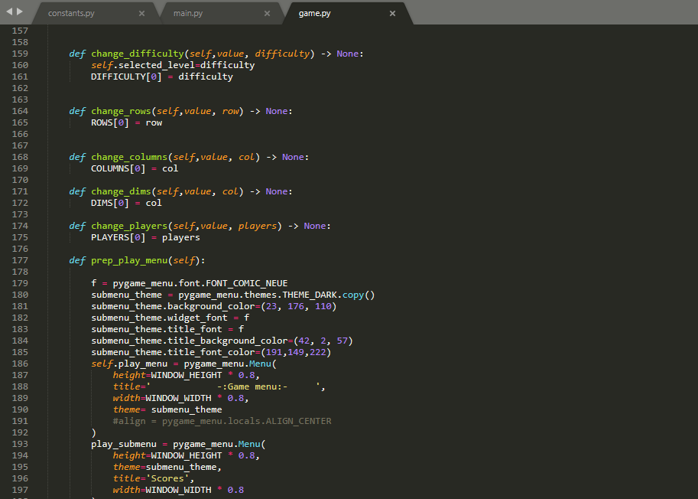
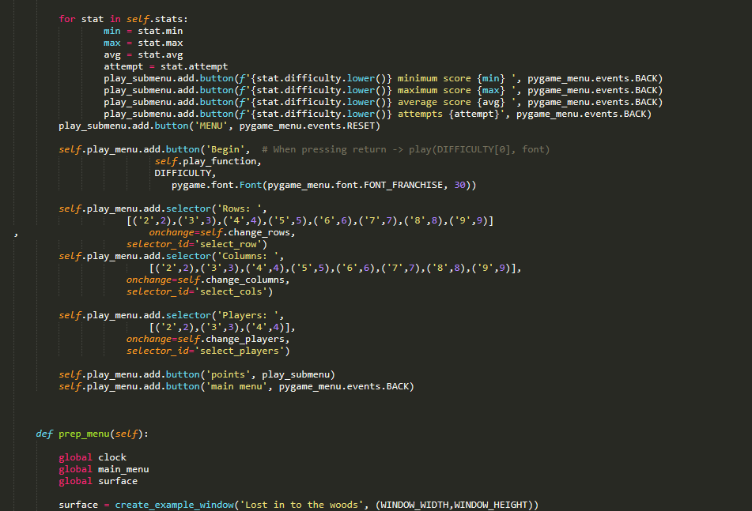
CODE (CONTINUED…)

Slide 11
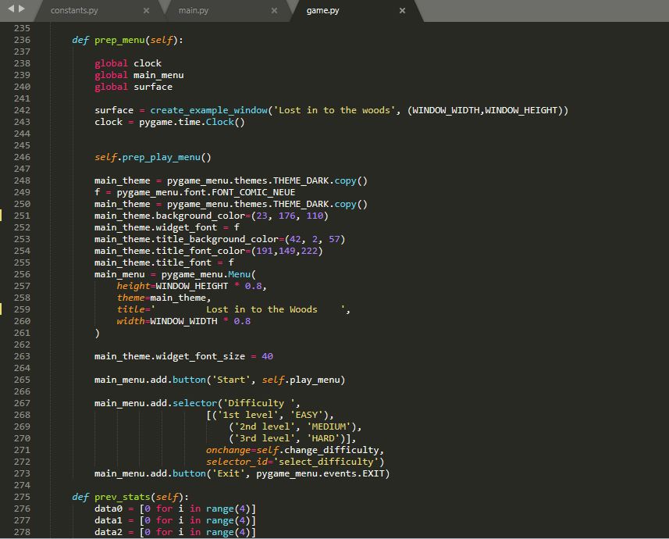
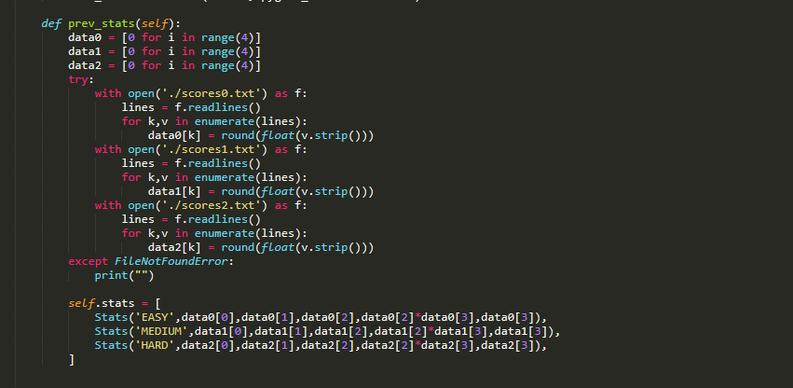
CODE (CONTINUED…)

Slide 12
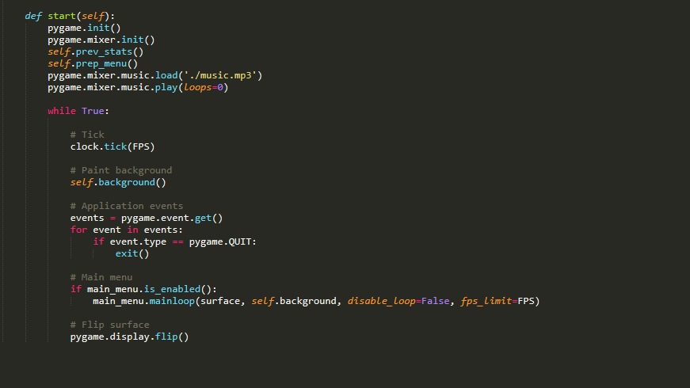
CODE (CONTINUED…)

Slide 13
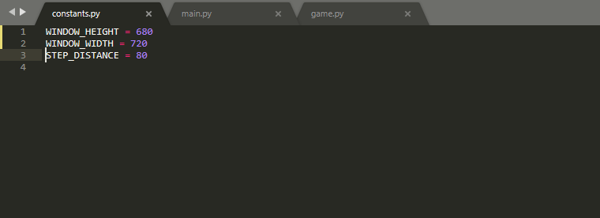
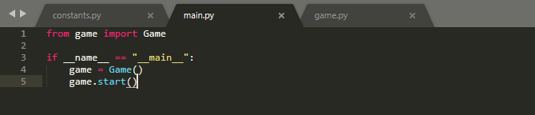
CODE EXECUTION

Slide 14
EVALUATION OF RESULT
Game interface reflects the following options:
Begins
Rows
Players
Points
Main Menu
3 players has been selected and previous scores have been seen in Score section.
Game ends up when 3 players meets at same square.

Slide 15
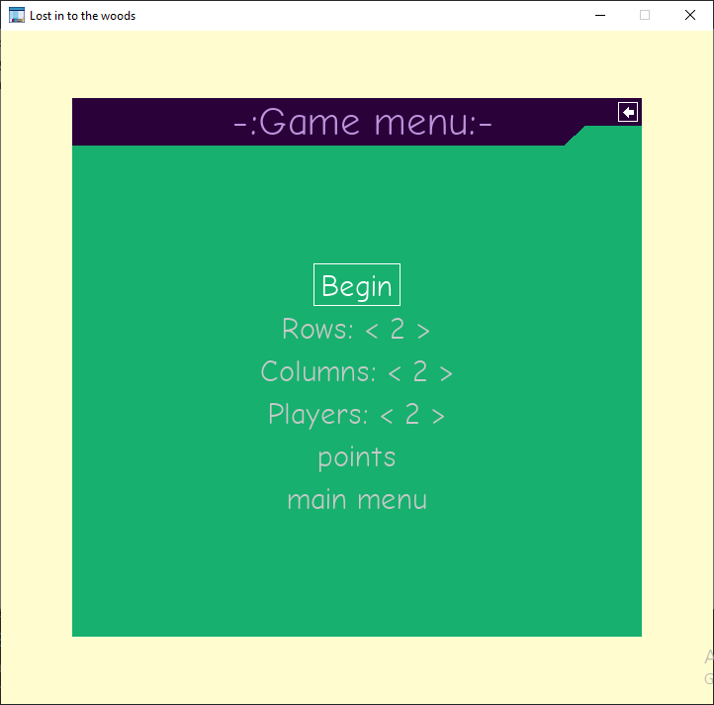

IMAGES OF GAME PLAY

Slide 16
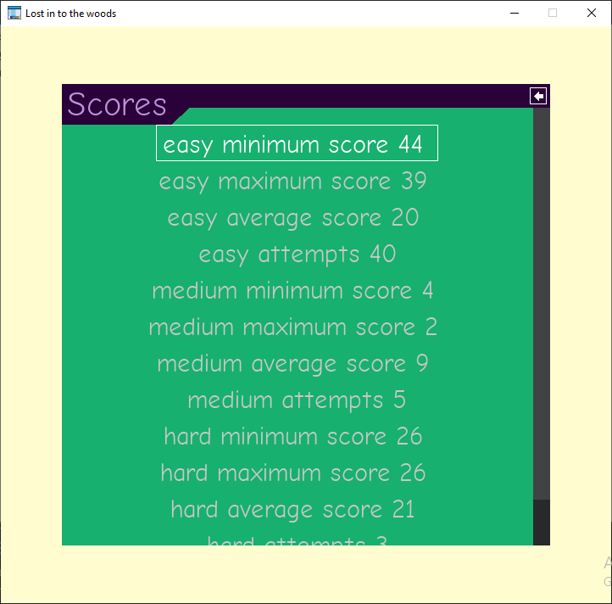
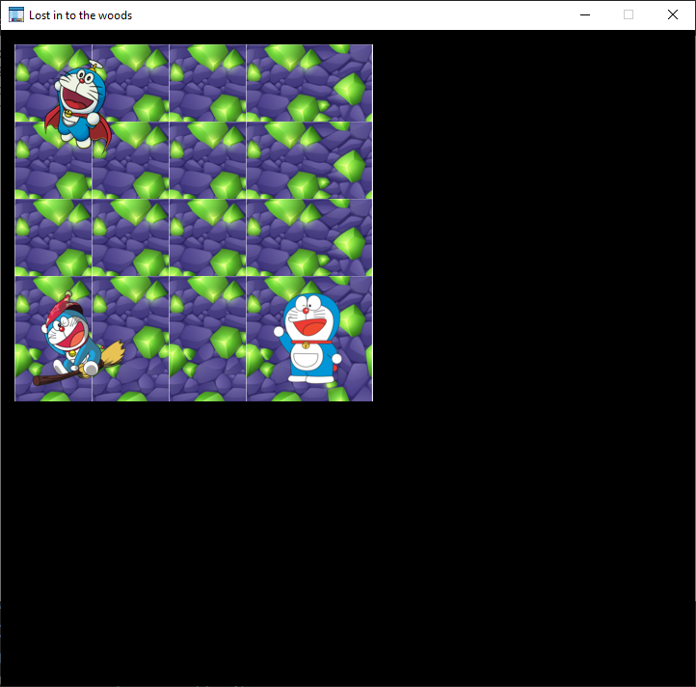
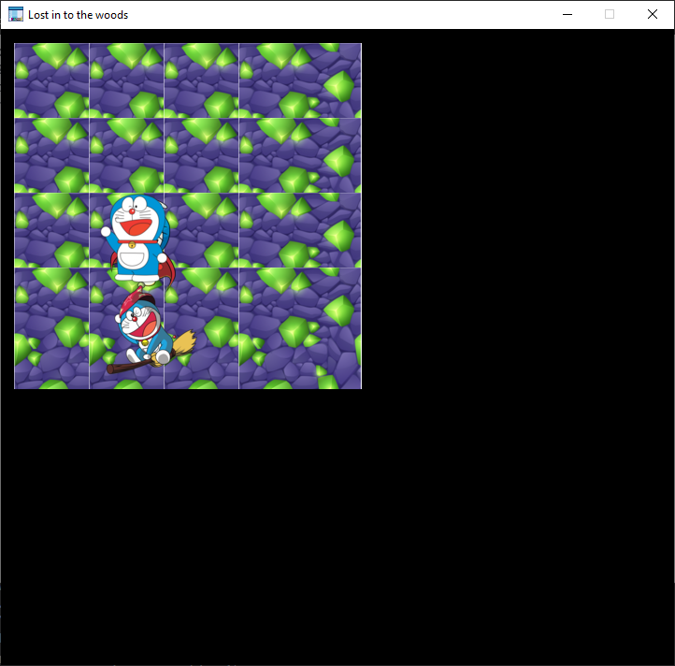
IMAGES OF GAME PLAY (CONTINUED…)

Slide 17
CONCLUSION
The study shed lights on extent of application of software engineering that leads to a productive application.
This project “Wandering-in-the-Woods” have successfully developed in the form of game application.

